Slide 1
.NET vs JAVA
Topics to be covered:
Introduction of .NET framework
JVM vs CLR
Platform vs Language Agnostic (Byte Code vs MSIL)
C# vs JAVA
Development tools – Visual Studio
Web Technologies
Open Source

Slide 2
Introduction to .NET Framework/C#
Successor to legacy Visual Basic, COM/COM++, DCOM for Microsoft
.NET 1.0 initial stable release – Feb 2002 (Java release - Jan 1996)
.NET 4.7 latest stable release – April 2017
Initial supported languages – VB.NET/C#.NET
VB.NET created for porting Visual Basic developers to new platform.
C# inventor - Anders Hejlsberg (chief architect for Delphi language based on Object Pascal)
C# was created 6 to 7 years after Java initial release. Microsoft got heads up on short fall with Java language and wanted to create better contemporary language.

Slide 3
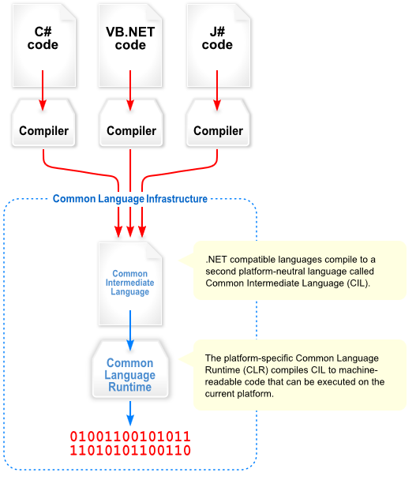
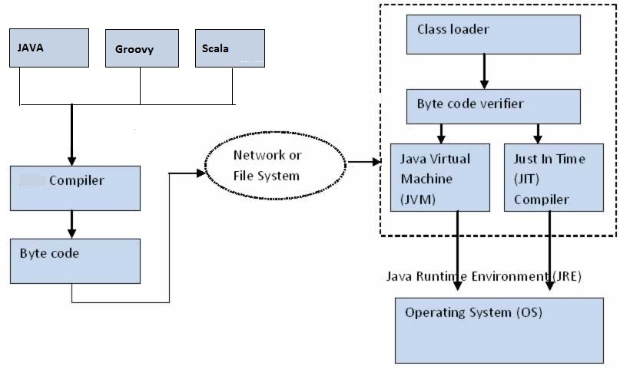
JVM vs CLR

Slide 4
Platform vs Language Agnostic (Byte Code vs MSIL)
Java is platform independent. Once it’s compiled to Bytecode, The code can run on any platform with specific version of JVM
C# is not platform independent. It compiles to assembly (.exe or .dll) in MSIL, MSIL code can only run on specific common language runtime for which it compiled.
MSIL - Microsoft Intermediate Language
ILASM/ILDASM - Intermediate Language Assembler/Disassembler,

Slide 5
C# vs JAVA
“Properties” for setting and getting fields
“Delegate” – function pointer
Multi cast “delegate”
Lambda expression
“using” – defining scope of the object
Need method for setting and getting fields
Functional interfaces
Chaining Method using functional interfaces
Lambda expression
Try with resources – define scope of the object

Slide 6
Web Technologies
Java Server Page (JSP)
Apache/Tomcat Server
ASP.NET – Active Server Pages
Use partial classes to separate UI designer code
IIS – Internet Information Services

Slide 7
.NET/Java Development tools
Visual Studio
Can be use to build solutions for most of Microsoft related development.
Solutions wrap related projects together.
Most of time upgraded every year with new features.
Proprietary software ☹
TFS – Team Foundation Server
Source control, Build and Release management etc.
Eclipse
Plugin base architecture, Need to work with different plugin to support different programing paradigm.
Open source
Apache Maven/Gradle
Build and Dependency management tools

Slide 8
Open Source
.NET/ASP.NET Core 1.0
Open source
Application developed with this framework will run on Linux.
Visual Studio Code
Code editor which can be use for different language related development, node.js etc.
Can work with different OS Linux, MAC OS etc.
Open source

